Slide 1
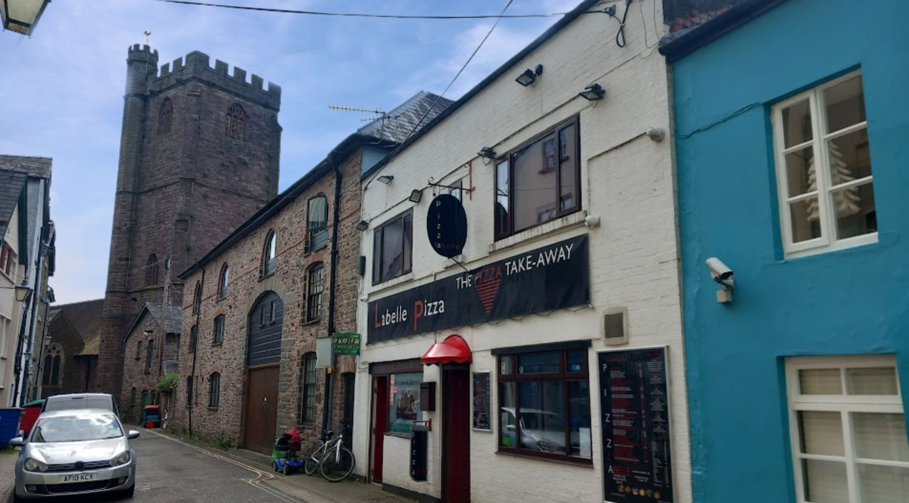
LaBelle Pizza
1 Church Lane, Brecon, Powys. LD3 7AS
Tenure: | Freehold | Price: | £245,000 | Ref: | 1160
Notes:
Subheadings: Tenorite (Body), Size 16, Colour #9d2200
Text: Tenorite (Body), Size 12, Colour Black, Line spacing 1.18

Slide 2
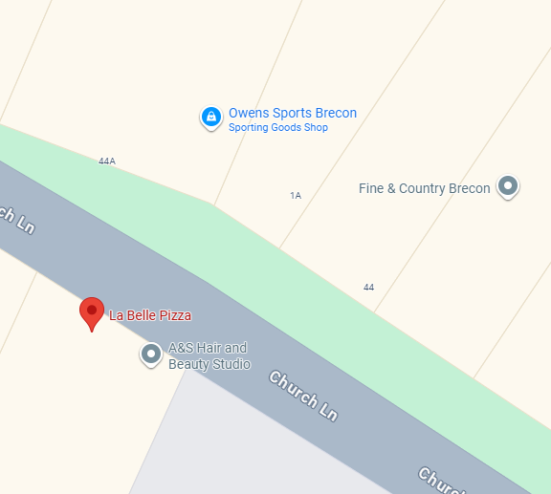
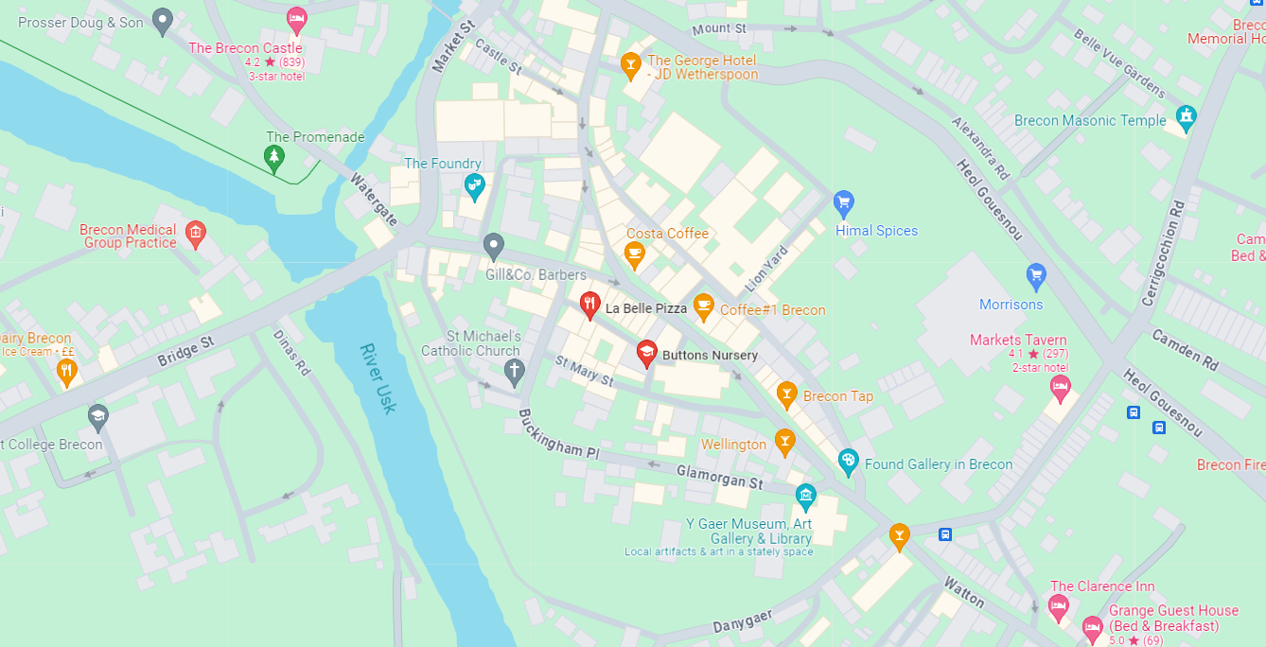
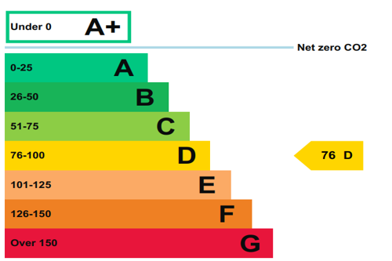
LaBelle Pizza is located on Church Lane at the heart of the busy tourist town of Brecon. It stands between some of the busiest public houses in the town centre and within a stone’s throw of the cinema and a large number of other retail and leisure outlets. Currently operating on limited hours, the business has previously opened late into the evening to take advantage of late night trade. Its position is perfect for a takeaway within this busy town, with road access for deliveries and large footfall from passing trade.
The thriving market town of Brecon is a popular destination on the northern edge of the Brecon Beacons National Park, enjoying outstanding views of its highest peak, Pen Y Fan. It also stands on a confluence of the Rivers Honddu and the Usk which meet close to the town, and is the most northern point on the navigable Monmouthshire and Brecon Canal. The Brecon Beacons is a mecca for outdoor enthusiasts, attracting hikers, cyclists and pony trekkers throughout the year, and the town of Brecon benefits greatly from this.
The town has an excellent level of amenities with further development ongoing. Within this busy town centre, La Belle Pizza is ideally placed to take advantage of the huge number of tourists and visitors throughout the year.
The business has been in the same owners hands since 1982 and has been extremely successful and profitable. For some time they have operated three evenings per week and only four to five hours per evening. There is huge scope to increase the trading hours and undoubted potential to change to any style of takeaway/restaurant business.
Notes:
Subheadings: Tenorite (Body), Size 16, Colour #9d2200
Text: Tenorite (Body), Size 12, Colour Black, Line spacing 1.18

Slide 3
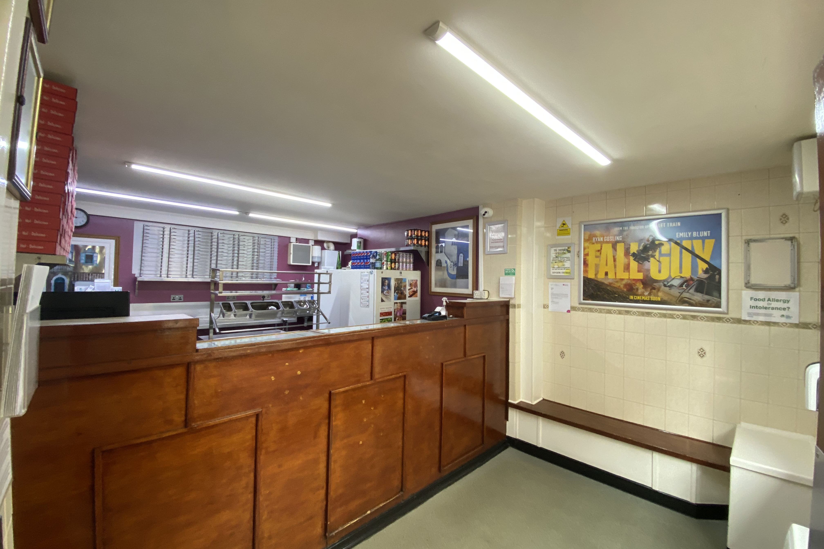
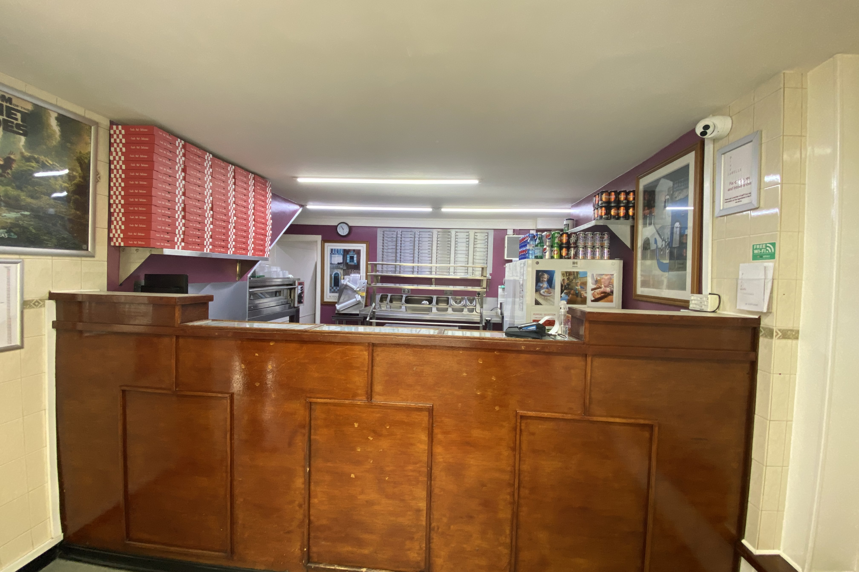
The first floor has previously been operated as a sit down restaurant, but more latterly used for storage. The owner is in the process of a small scale development that could turn it Into a private flat with minimal work.
Trade Areas
GROUND FLOOR : Main ENTRANCE VESTIBULE leading into entrance foyer having bench seating for four with service area and counter. Working PIZZA KITCHEN behind.
The working area has a tile floor and a good selection of stainless steel work surfaces incorporating work stations, pizza racking and a pizza oven. Two large refrigerators. Access to rear STORE and MIXER ROOM having quarry tile floor, a large quantity of freezers and a lockable store.
FIRST FLOOR : Stairs leading to a central room which has the potential to become a KITCHEN/LOUNGE AREA with access to SHOWER ROOM and WC. Two separate doors leading into a LARGE ROOM which could be utilised as a bedroom or split into two to provide two smaller bedrooms. Note: this area was previously a restaurant with fitted Kitchen and Ladies’ and Gentlemen’s toilets off. The Restaurant seated 24. Our clients currently use the area for storage but it could easily be reconfigured as a private flat (subject to Building Regulations consent), or converted back to a trading space.
The Business
The business has been successfully operated by the current owners since 1982 which is testament to its success. It has only become available due to retirement. Despite working seven days a week in the early years, it has for some time operated on a part time basis on Friday, Saturday and Sunday evenings, and for only four hours per evening. The current owners decided to operate on this basis to suit their lifestyle and they have found it extremely profitable in relation to the hours worked.
Notes:
Subheadings: Tenorite (Body), Size 16, Colour #9d2200
Text: Tenorite (Body), Size 12, Colour Black, Line spacing 1.18

Slide 4
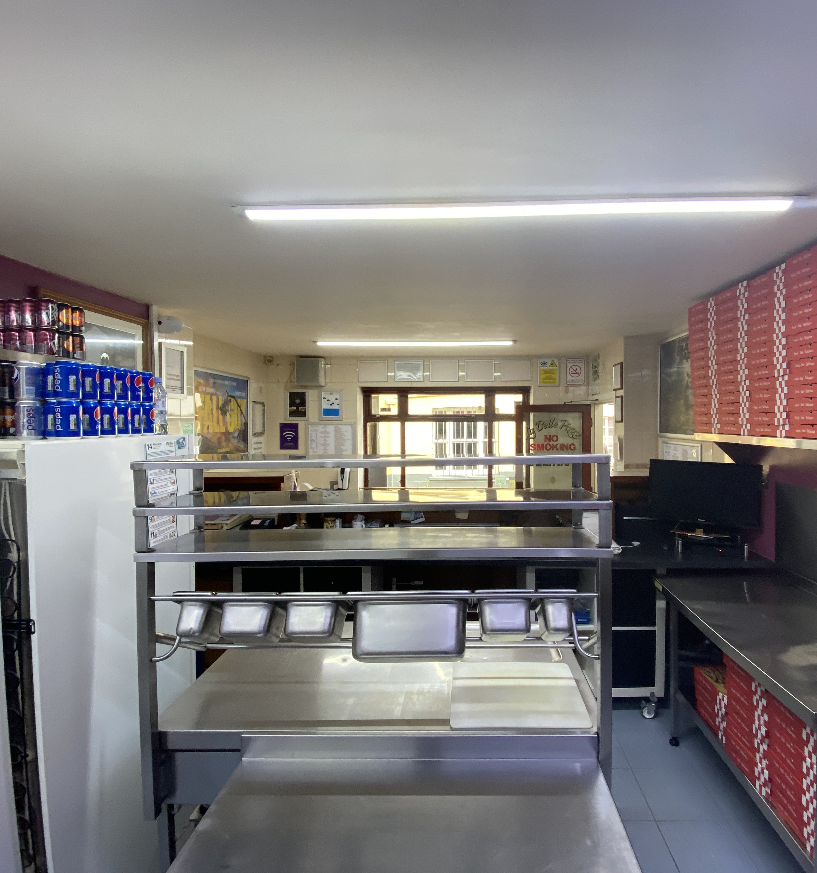
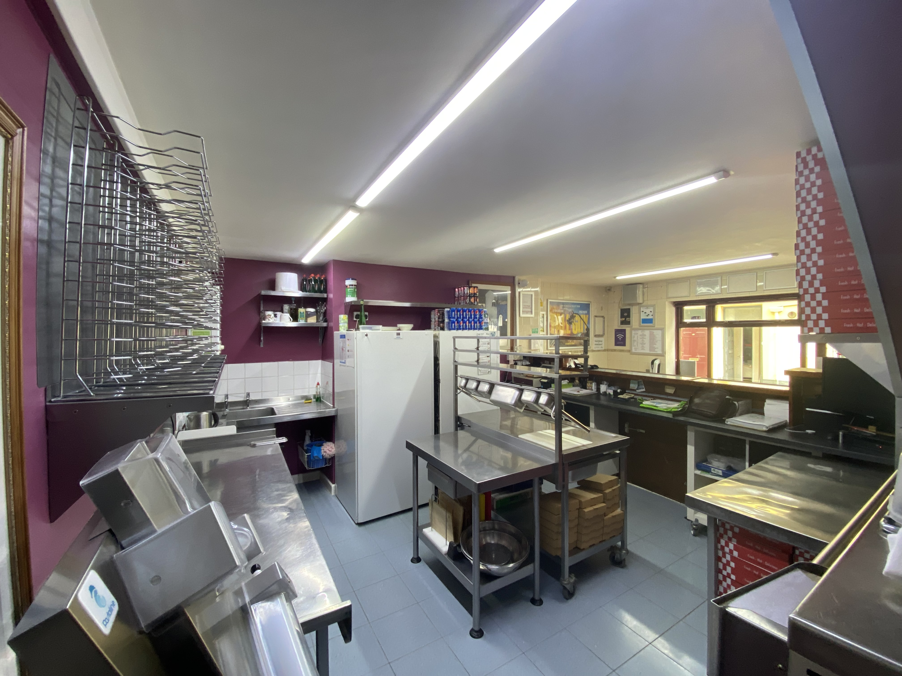
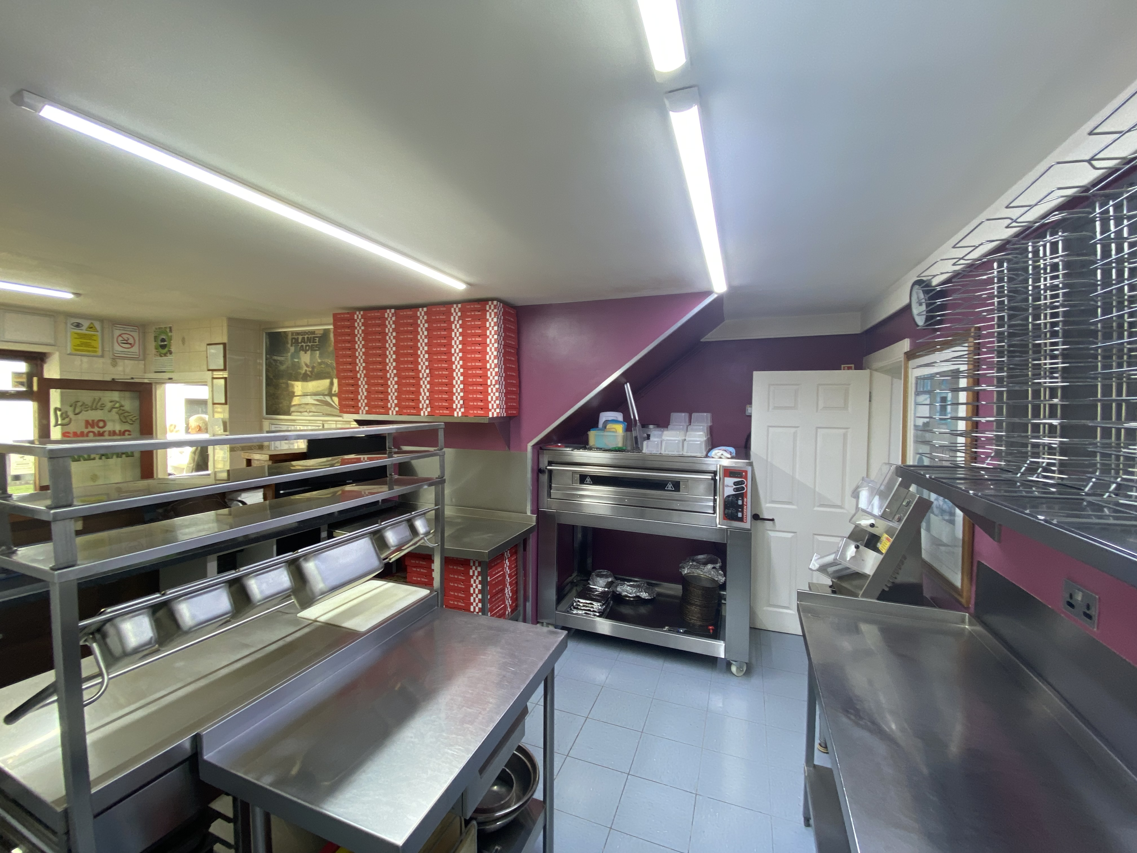
There is undoubted scope to greatly increase the trading hours, or change the style of trade from the unit as it would suite all types of takeaway/restaurant operations. The current owners choose to operate under the VAT threshold.
For the financial year ending 31 March 2024, sales net of VAT of £84,976 were achieved on only 105 days trade. From this, an excellent level of net profit was achieved.
Tenure & Price
FREEHOLD £245,000 to include goodwill and fixtures and fittings. Stock at valuation in addition.
No direct approach to be made to the business; please direct all communications through Sidney Phillips.
Viewing strictly by appointment only.
Licences
No premises licence is held. The first floor has previously been licensed when operating as a restaurant.
Services
All mains services are connected. There is a separate electricity supply to ground and first floor levels.
Local Authority: Powys County Council
Cambrian Way, Neuadd Brycheiniog, Brecon. LD3 7HR
Rateable Value: £4,250 as at 01 April 2023
(currently receiving 100% break relief as at June 2024)
Notes:
Subheadings: Tenorite (Body), Size 16, Colour #9d2200
Text: Tenorite (Body), Size 12, Colour Black, Line spacing 1.18

Slide 5
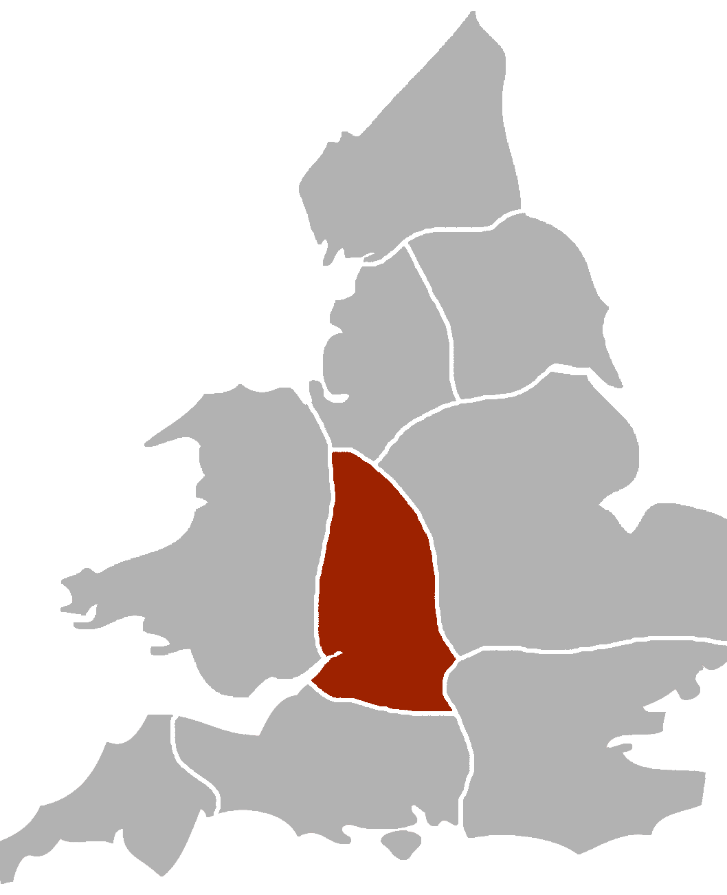
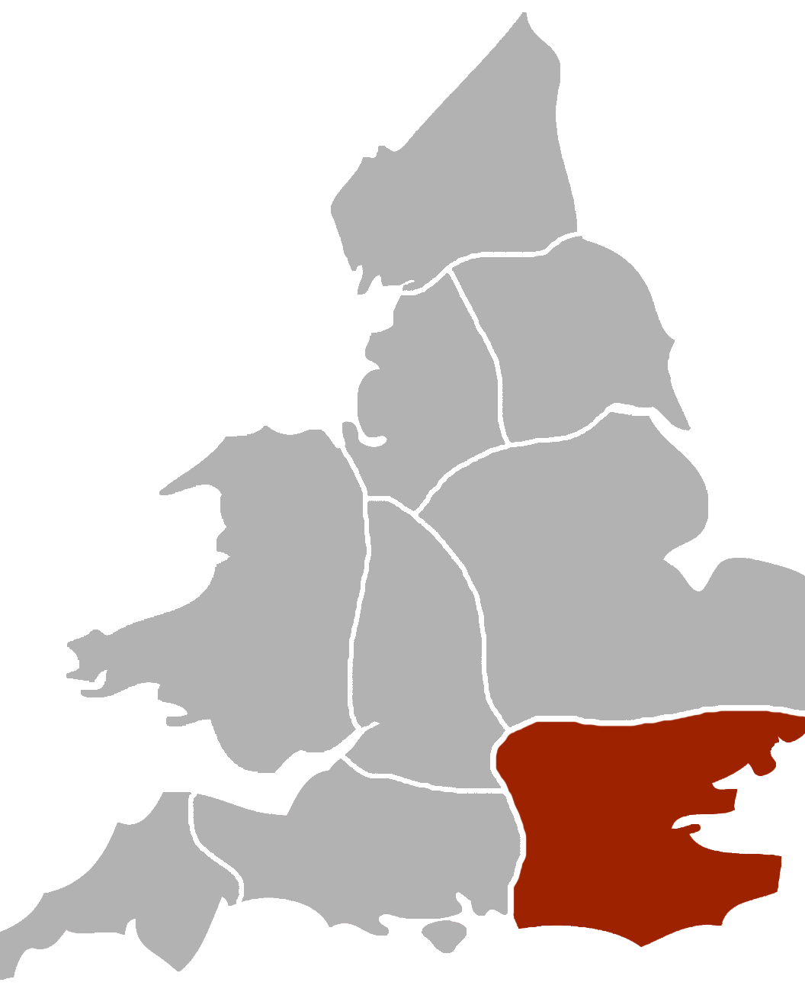
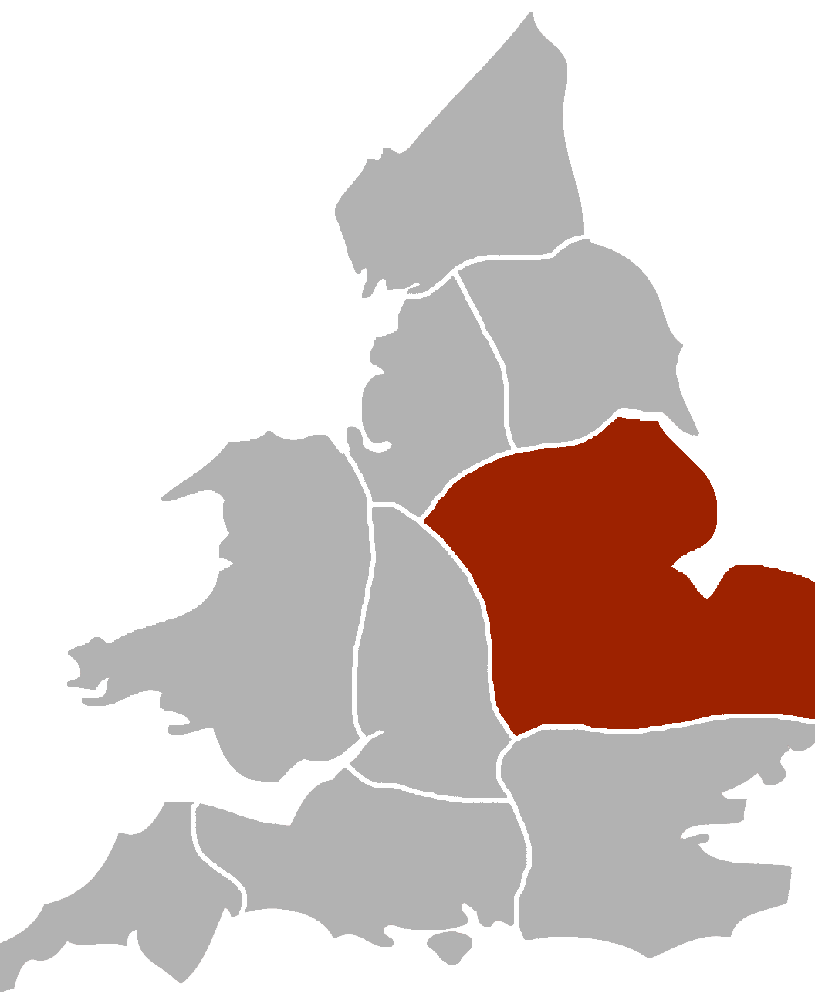
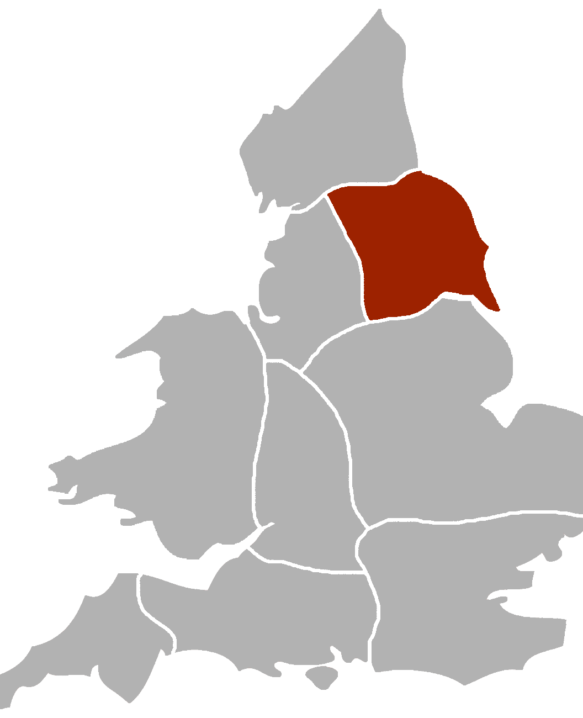
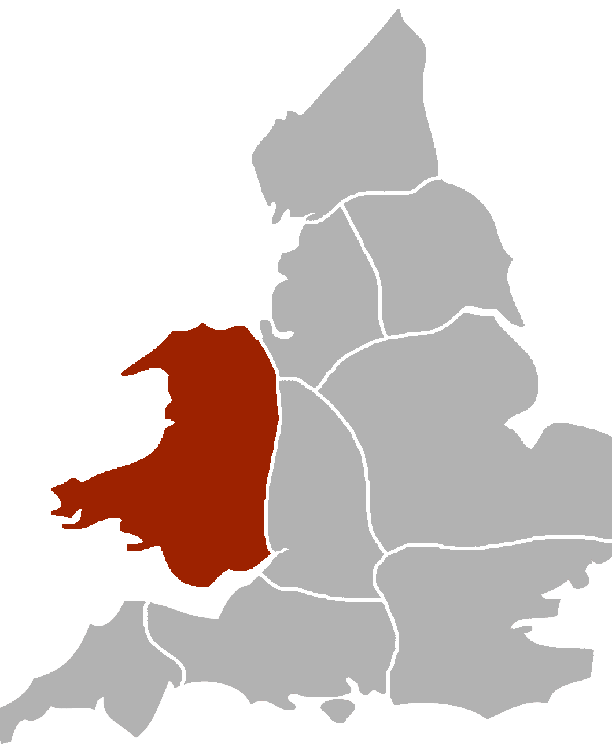
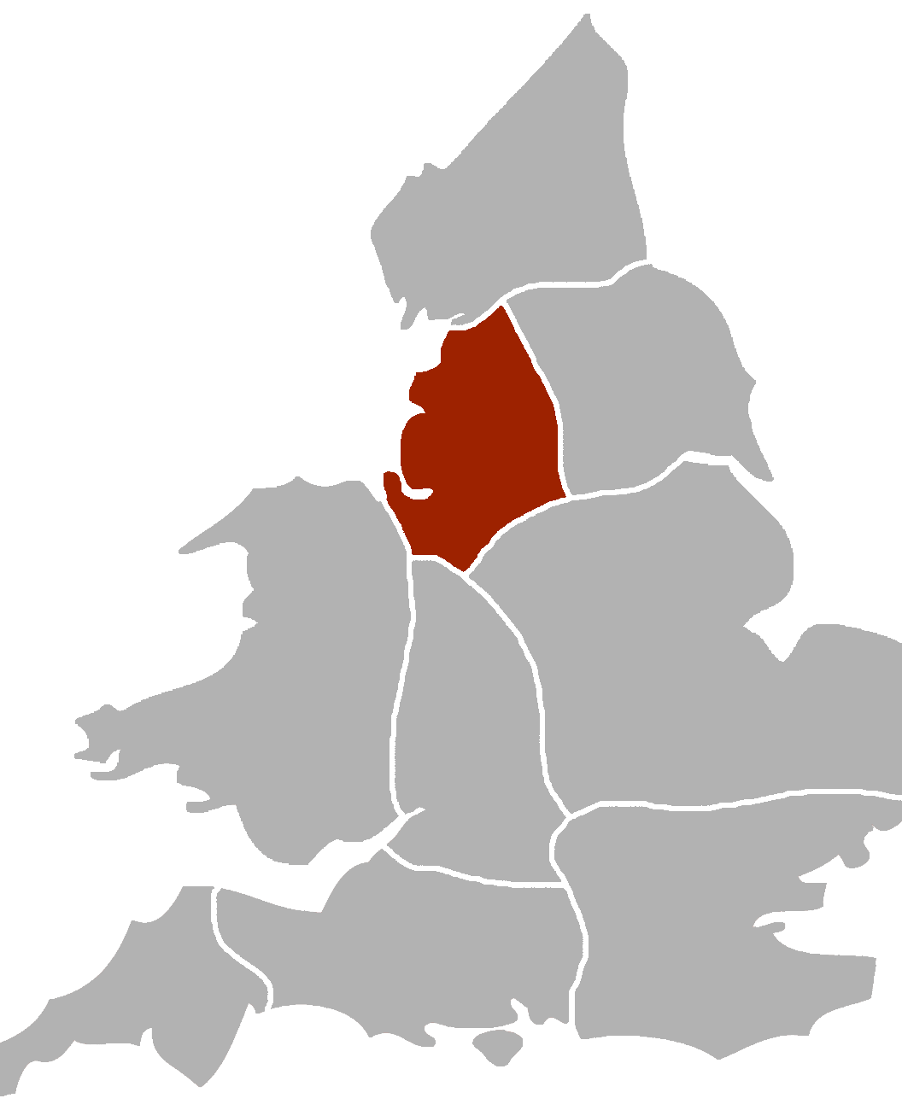
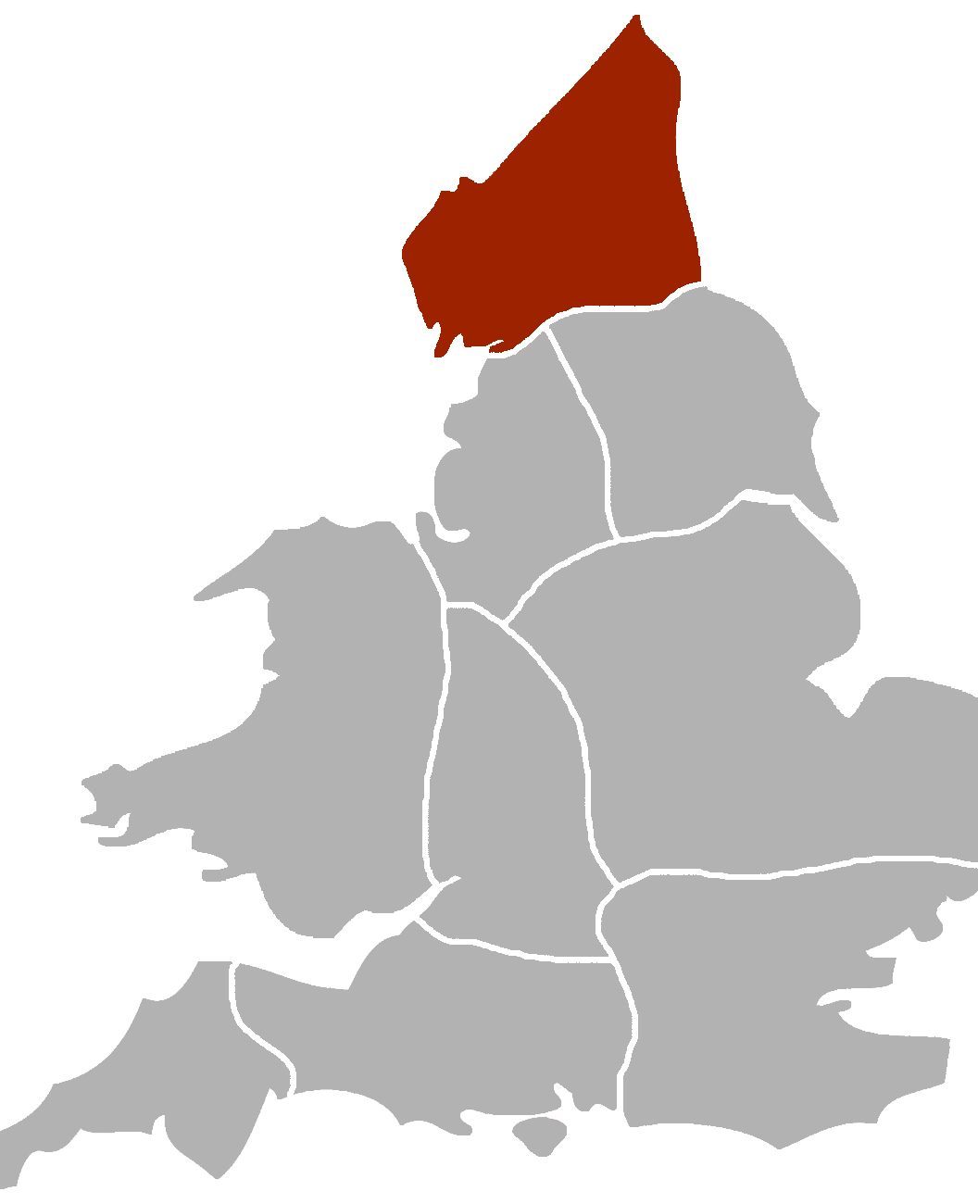
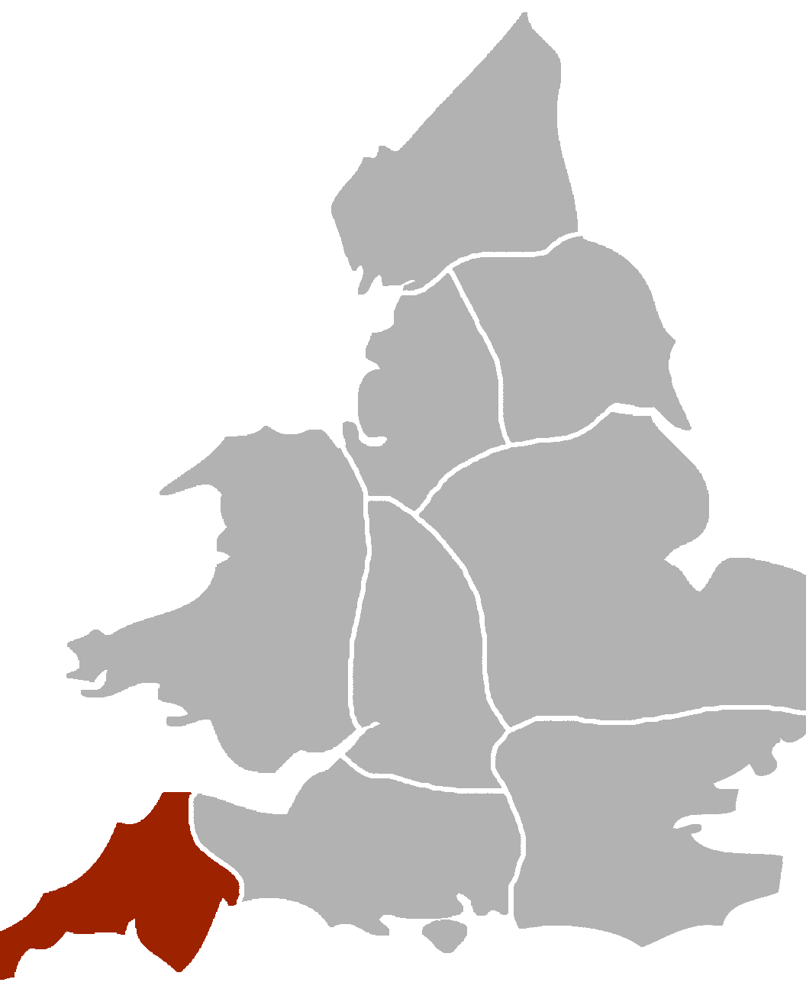
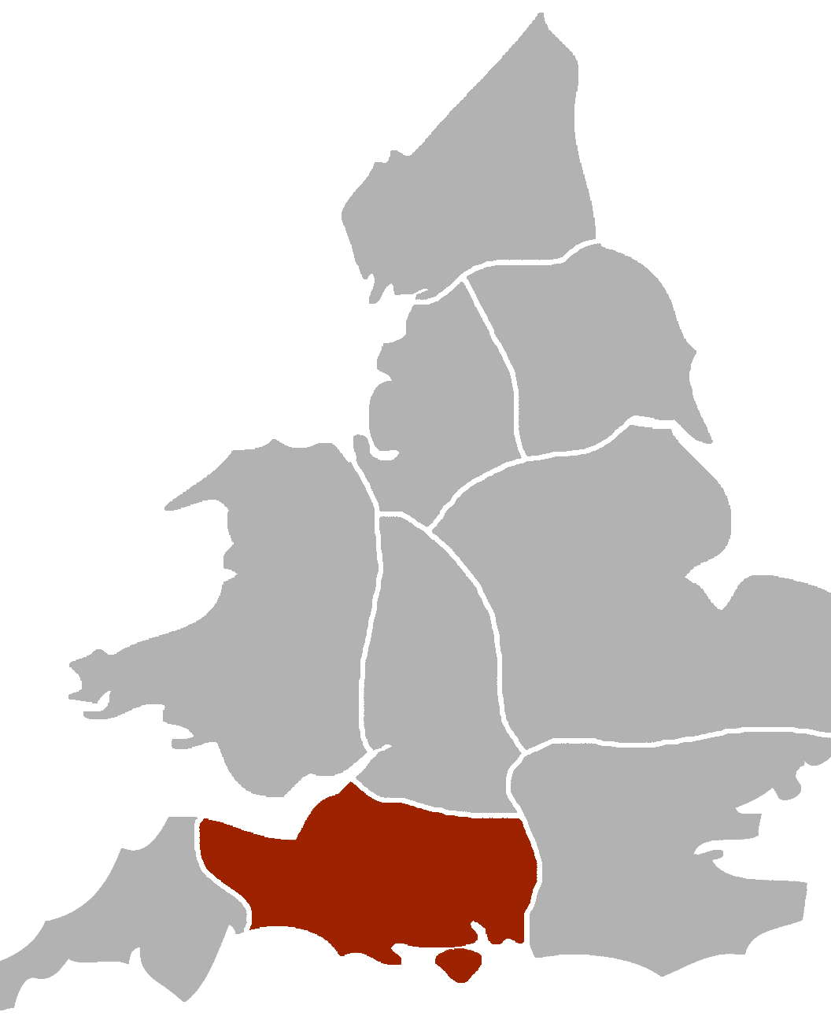

Midlands
London & South East
Eastern Counties
Yorkshire
01981 250333
midlands@sidneyphillips.co.uk
01892 725900
southeast@sidneyphillips.co.uk
01522 500059
east@sidneyphillips.co.uk
01904 793333
yorkshire@sidneyphillips.co.uk
Wales
North West
Northern Counties
Devon & Cornwall
01981 250333
wales@sidneyphillips.co.uk
01512 204879
northwest@sidneyphillips.co.uk
01434 607841
north@sidneyphillips.co.uk
01752 234180
devoncornwall@sidneyphillips.co.uk
Business Mortgages
01834 849795
We can help to arrange funding for your purchase of this or any other business.
Wessex
Europe
Utility Helpline
01460 259100
wessex@sidneyphillips.co.uk
01892 725900
europe@sidneyphillips.co.uk
01432 378690
Some of our clients have reduced their gas and electricity bills by up to 46% using our impartial price comparisons.
Notes:
DO NOT EDIT THIS PAGE

